Slide 1
Lecture 9
External Sorting
Instructor: 黄群
huangqun@pku.edu.cn
School of EECS
Peking University

Slide 2
Outline
Primary & secondary storages
External sorting algorithms

Slide 3
Primary and Secondary Storages
Primary storage (main memory, internal memory, …)
Random access memory (RAM)
Cache
Secondary storage (peripheral storage, external memory, …)
Non-volatile memory
Solid-state drive (SSD)
Hard disk drive (HDD)
Tape drive
Notes:
Tertiary storage (robotic mechanism to mount/dismount): tape library, optical jukebox;
Offline storage: human interaction involved.
Sneakernet:
DVD (4.7 GB) BW 50kB/s (ms latency) vs. BW 1305kB/s (1hr latency);
Boeing 747 filled with Blu-ray Discs is 595,520,000 Gigabytes, resulting in a 245,829 Gbit/s flight from New York to Los Angeles;
LTO-5 (1500 GB) tape, 20 hours overnight, 166 Mbit/s.

Slide 4
Peripheral Storage: Pros & Cons
Pros: cheap, non-volatile
Cons: high access latency
the access time of main memory is in the order or nanoseconds (10⁻⁹ s), while the access time of external storage is in the order from milliseconds (10⁻³ s) to seconds
Minimize the external accesses to reduce the execution time of your program
Notes:
Latin phrase: pro et contra (for and against)

Slide 5
Main Memory: Pros & Cons
Pros: low access latency
Cons: expensive, volatile*
* not any more for non-volatile memory
The data access time from CPU to the directly attached memory can be treated as a small constant in your algorithm analysis

Slide 6
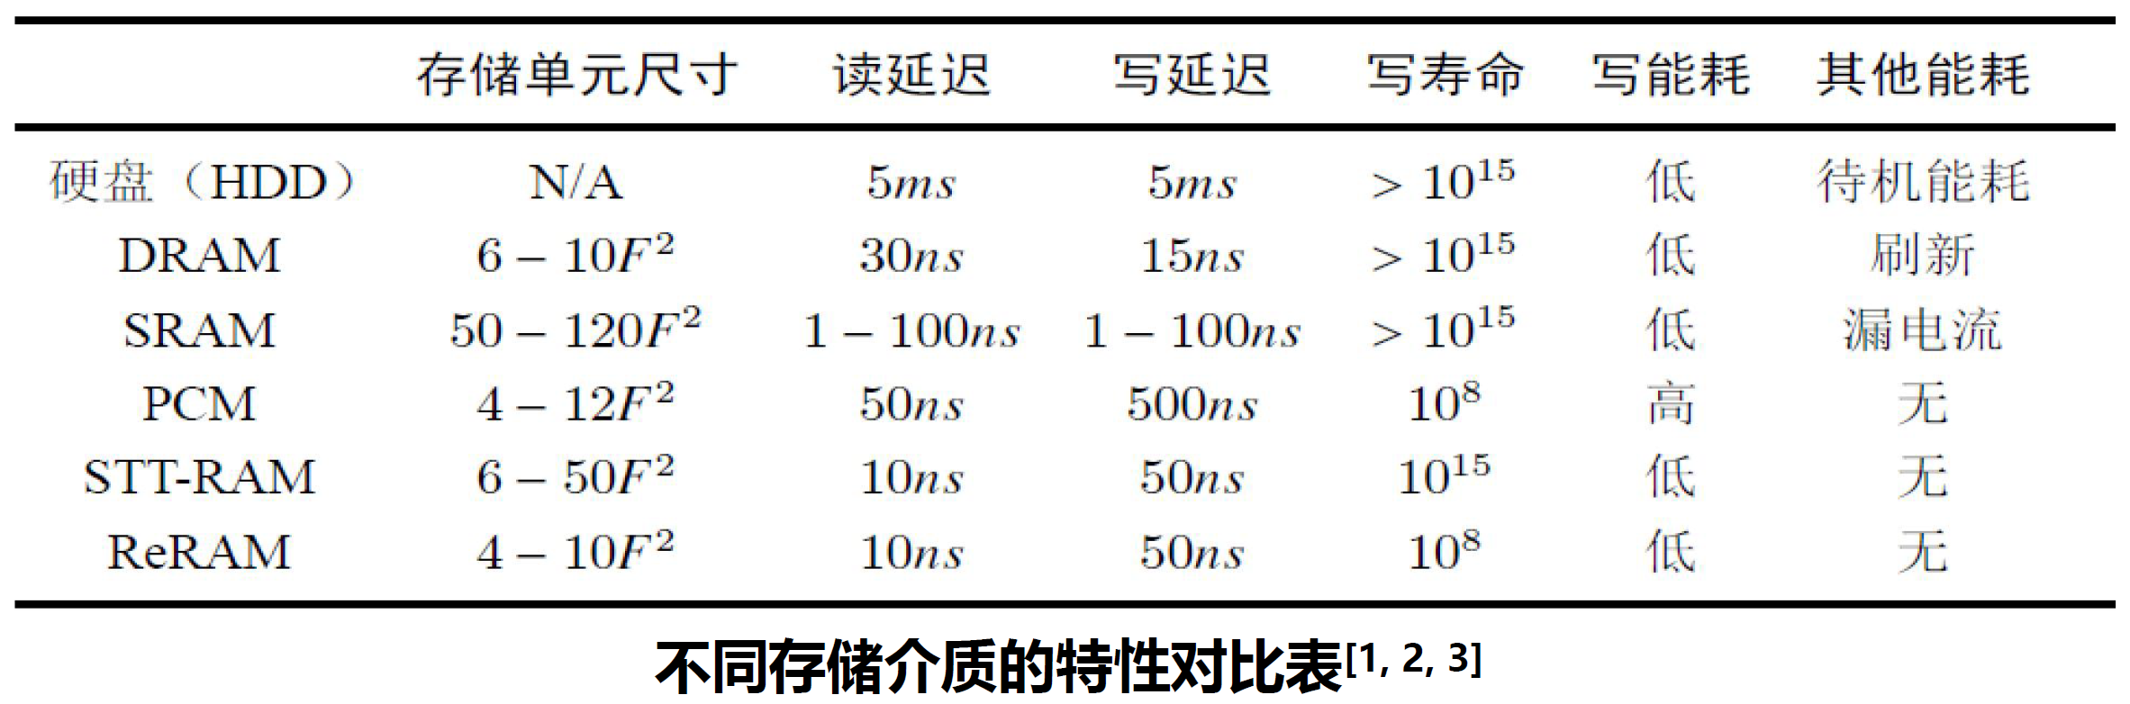
Performance Comparison

Slide 7
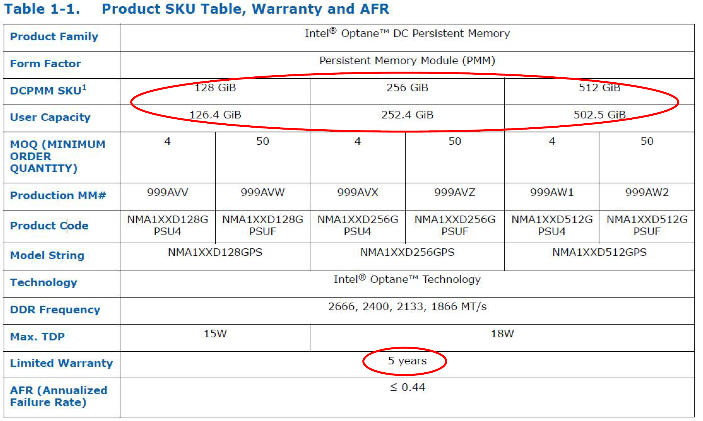
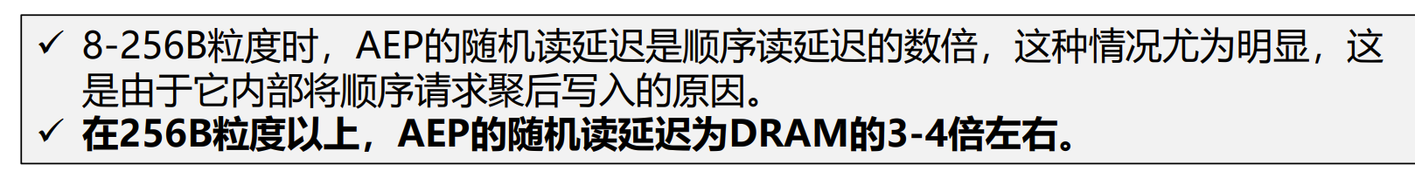
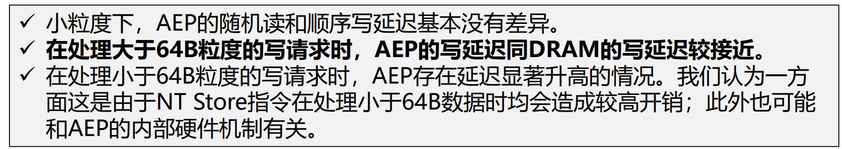
Performance Comparison: Intel Optane
Named as Apache Pass (AEP) at first

Slide 8
Outline
Primary & secondary storages
External sorting algorithms

Slide 9
External Sorting
External sorting algorithms
When the data cannot fit in the main memory
Have to be aware of the external storage
Key idea
Partition the data into multiple segments
Sort each segment in memory.
A sorted segment is a run (顺串, 归并段)

Slide 10
External Sorting
It usually consists of two independent algorithms
Generate runs as long as possible
Merge the runs, and obtain the fully sorted data
Three parts of runtime
Runtime of the in-memory sort
Runtime of the data access
Runtime of the merging
The key: minimize the external data access

Slide 11
Outline
Primary & secondary storages
External sorting algorithms
Generate runs: replacement selection algorithm
Merge runs
Two-way merge
Multi-way merge (selection trees)

Slide 12
Generate Runs
Conceptually, all internal sorting algorithms can be used
Quick Sort
Merge Sort
Insert Sort
…

Slide 13
Generate Runs
However, consider the later merge process
The length of runs directly affect the performance of merge
If we have m runs, and perform a k-way merge
The number of merges is [log_{k}m]
Thus, longer runs are preferred
i.e., the number of runs decreases

Slide 14
Execution Model of Previous Internal Sorting
Load-Sort-Store model
Each run has n records
Sorting
Algorithm
Input
File
Read n records
A run of n records
Output
File
At most n records

Slide 15
Replacement Selection Algorithm
Key idea: repeatedly
Output a small record to output file (Select)
Read a new record from input file (Replace)
If the new record is large (than the output record)
The new record can belong to the same run
Otherwise, the new record is small
Start a new run with the new record (after all existing records are output)

Slide 16
How to?
Use a heap to maintain all in-memory records
Easily select the minimum record
Array-based implementation
When need to start a new run, just put the new small record at the end of array

Slide 17
Example
Output 16, Insert 29
Maintain Heap
>16
Input
Memory
Output
19<29
16
29
12
14
19
31
35
13
25
21
56
40
21<25<29

Slide 18
Example
Maintain Heap
Output 21, Insert 35
Output 19, Insert 14
<19
>21
<25
Input
Memory
Output
14
19
40>31>21
35>31>25
16
56>31>29
35
12
21
31
13
40>29>25
35>29
×
×
56>40>35
25
29
56
40

Slide 19
Sample Code
// Repeatedly call replacementSection(), each call generates one run
// A: an array of n elements from input file
// in, out: input and output file
template <class Elem>
void replacementSelection(Elem * A, int n, Buffer<Elem> * input, Buffer<Elem> * output) {
Elem r; // Used to read new record
initMinHeapArry(input, n, A);
MinHeap<Elem> H(A, n, n); // Build heap
for(int last = (n-1); last >= 0; ){
Elem mval = H.heapArray[0]; // Get minimum value
sendToOutputBuffer(output, mval);
input.read(r); // Read next record
if (r >= mval)
H.heapArray[0] = r; // r belongs to this run, put it in the root
else { // use last element as root
H.heapArray[0] = H.heapArray[last];
H.heapArray[last] = r;
H.setSize(last--); // r is in the next run
}
H.SiftDown(0); // Maintain heap
}
endUp(); // Gather remaining elements for next run
}

Slide 20
Analysis
The generated runs have different lengths
Assume the heap has size n
Longest run: a single run containing all elements
If all elements are already sorted in input file
Shortest run: length n
At least as good as other internal sorting algorithms
Average length: 2n

Slide 21
About Average Case
When starting a new run
Build a heap with n elements
Each time output an element from the heap
Before all the original n elements are output
How many new elements can be inserted into the heap (and then output in the same run)
Depends on input

Slide 22
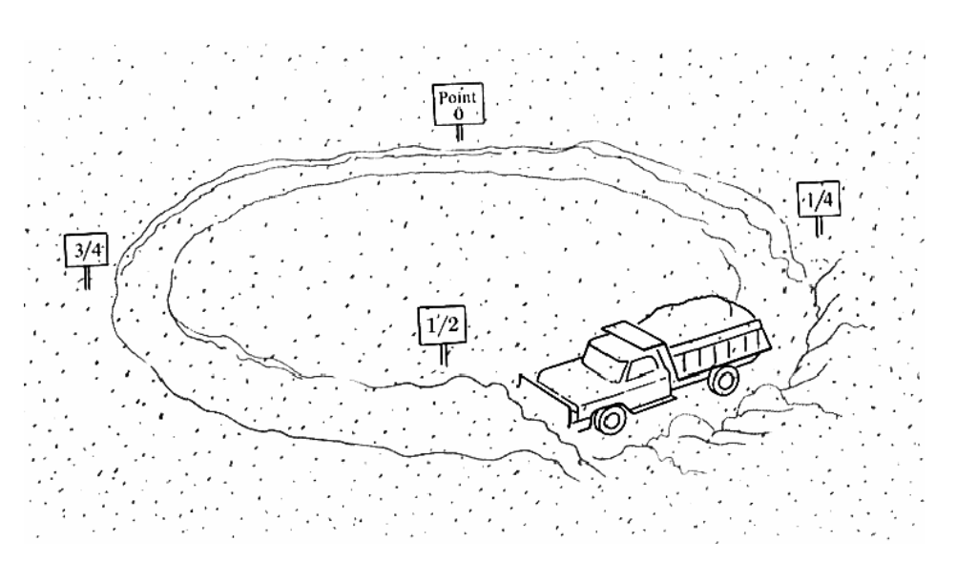
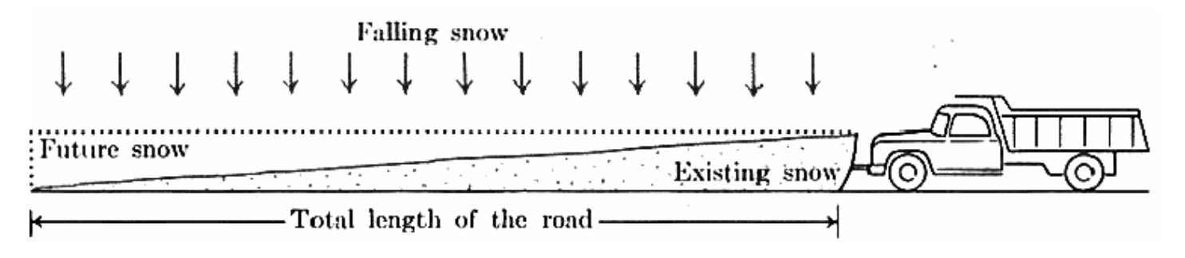
An Intuitive Interpretation of Average Case
1. Snow falls at constant rate and uniform distribution
2. Snowplow moves at constant speed
Data inserted in the future
Data already in heap
Circular Road with a Snowplow
Stabilized situation
A formal proof is done by Knuth
Based on density distributions and integral
《The Art of Computer Programming》: Volume 3, Sorting and Searching

Slide 23
Outline
Primary & secondary storages
External sorting algorithms
Generate runs: replacement selection algorithm
Merge runs
Two-way merge
Multi-way merge (selection trees)

Slide 24
Two-Way Merge
Goal
Merge the runs generated by Replacement Selection
Approach
Select two runs
Read their records from begin to end
Perform merge operation as Merge Sort

Slide 25
Two-Way Merge
The order of selected runs determine the performance
Prefer to merge short runs
As Huffman Trees

Slide 26
Two-Way Merge
Number of block
in a run
Number of block read

Slide 27
Outline
Primary & secondary storages
File management
External sorting algorithms
Generate runs: replacement selection algorithm
Merge runs
Two-way merge
Multi-way merge (selection trees)

Slide 28
K-Way Merge
Increasing the number of ways in merging
Merge k runs at a time
Assume we have m initial runs, and perform a k-way merge, the number of merges is [log_{k}m]
Problem
Time-consuming to find the minimum among k values each time
Better to use a selection tree
A complete binary tree (a winner tree or a loser tree)

Slide 29
K-Way Merge

Slide 30
Winner Tree
Array B:
A complete binary tree
Store winner index in array L
Array L:
Current element in each run
k runs to be merge

Slide 31
Winner Tree (Output Winner)
2. Only the path from L[i] to root need to be updated
Array B:
A complete binary tree
Store winner index in array L
Array L:
Current element in each run
k runs to be merge
1. Update winner’s L[i]

Slide 32
Winner Tree: Operations
When a node is updated, need to
Compare with the sibling
Update its parent
Easy in Complete Binary Tree

Slide 33
Winner Tree: Structure (if N is even number)
N: number of external nodes (number of ways)
LowExt: number of external nodes in last level
Offset: number of nodes excluding last-level nodes (internal nodes + external nodes not in last level)
n=6, LowExt=4, Offset=7
LowExt + Offset = 2n-1
Access sibling of L[i]
i+1 (i is odd number)
i-1 (i is even number)
Access sibling and parent of B[i]
Normal operations of Complete Binary Trees
Access parent of L[i]

Slide 34
If n is odd number

Slide 35

Loser Tree: Motivation
In Winner Tree
Duplicated information in B[i]
After the final winner is output, all its information becomes useless
After updating a node, need access two nodes
Compare sibling
Update parent
If we record loser instead of winner?
Simplified update
Loser information is more important

Slide 36
Loser Tree
An variant of winner tree
Parent node is the loser of two contestants
Winner is advanced in the next competition
An extra node on top of the node to represent the winner in all contests
Simplified tree updates

Slide 37
Update Procedure
After removing the minimum node (final winner)
Update external node by reading a new record from the corresponding run
Compare the node with its parent
Update the parent with the new loser
Advance the winner to the upper level
Continue to the root
Loser at the top level : B[1]
Winner at the top level: B[0]

Slide 38
Final Winner
L[2]<L[6]
L[2]>L[5]
L[2]<L[4]
5
L[6]<L[8]
L[3]>L[4]
2
8
L[5]>L[6]
3
4
5
6
6
8
15
16

Slide 39
Comparison
Winner tree
Compare between siblings
Loser tree
Compare child and parent
Heap
Compare between siblings first
Then compare smaller child with parent

Slide 40
Loser Tree ADT
template<class T>
class LoserTree{
private:
int MaxSize; // Maximum competitors
int n; // Current competitors
int LowExt; // External nodes in last level
int offset; // Nodes above last level
int * B; // Loser tree array (store index of L)
T * L; // Element array

Slide 41
Loser Tree ADT
public:
LoserTree(int Treesize = MAX);
~LoserTree(){delete [] B;}
void Initialize(T A[], int size, int (*winner)(T A[], int b, int c), int(*loser)(T A[], int b, int c));
int Winner(); // Get winner
// Update tree
void Play(int p,int lc,int rc,int(*winner)(T A[],int b,int c)); // On init
void RePlay(int i, int(*winner)(T A[], int b, int c), int (*loser)(T A[], int b, int c)); // On removing i
};
template<class T>
int LoserTree<T>::Winner(){
return (n)?B[0]:0;
}

Slide 42
Loser Tree: Init
template<class T>
void LoserTree<T>::Initialize(T A[], int size, int(*winner)(T A[], int b, int c), int(*loser)(T A[], int b, int c)) {
if (size > MaxSize || size < 2) {
cout<<"Bad Input!"<<endl<<endl; return; }
n = size; L = A;
int i,s;
for (s = 1; 2*s <= n-1; s+=s);
LowExt = 2*(n-s);
offset = 2*s-1; // calculate variables
for (i = 2; i <= LowExt; i+=2) // External nodes at last level
Play((offset+i)/2, i-1, i, winner, loser);
if (n%2) { // n is node, one external node plays with internal node
Play(n/2,B[(n-1)/2],LowExt+1,winner,loser); i = LowExt+3;
}
else i = LowExt+2;
for (; i<=n; i+=2) // Remaining external nodes
Play((i-LowExt+n-1)/2, i-1, i, winner, loser);
}}

Slide 43
Loser Tree: Play
template<class T>
void LoserTree<T>::Play(int p, int lc, int rc,
int(* winner)(T A[], int b, int c), int(* loser)(T A[], int b, int c)){
B[p] = loser(L, lc, rc); // Record loser
int temp1 = winner(L, lc, rc); // get winner
while(p>1 && p%2) { // if B[p] is right child: path to root
int temp2 = winner(L, temp1, B[p/2]);
B[p/2] = loser(L, temp1, B[p/2]);
temp1 = temp2;
p/=2;
} // End while: B[p] is left child or B[1]
B[p/2] = temp1;
}

Slide 44
Loser Tree: RePlay
template<class T> void LoserTree<T>::RePlay(int i,
int (*winner)(T A[], int b, int c), int (*loser)(T A[], int b, int c)){
int p;
if (i <= 0 || i > n) {
cout<<"Out of Bounds!"<<endl<<endl; return; }
if (i <= LowExt) // get parent
p = (i+offset)/2;
else p = (i-LowExt+n-1)/2;
B[0] = winner(L, i, B[p]);
B[p] = loser(L, i, B[p]);
for(; (p/2)>=1; p/=2) { // path to root
int temp = winner(L,B[p/2], B[0]);
B[p/2] = loser(L,B[p/2], B[0]);
B[0] = temp;
}
}

Slide 45
Loser Tree Operations
Initialize: O(n)
Recall that there are n-1 internal nodes
Get winner: O(1)
Remove winner and replay: O(log n)

Slide 46
Efficiency of K-Way Merge
Merge k runs, there are n elements after merging
Naive method
O(k) time to find the minimum
O(kn) total time
Loser tree
O(k) time to initialize
O(log k) time to remove the minimum and update the tree
O(k + n log k) total time

Slide 47
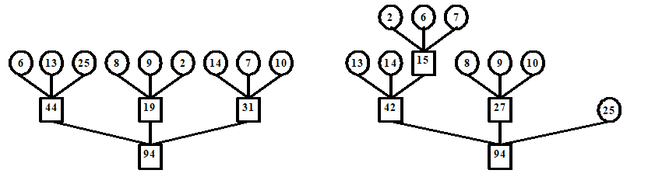
Best K-Way Tree
Each time select the k smallest runs to merge
Total read: 188 Total: read 178

Slide 48
Summary
Main memory and external storage
Ideas of external sorting
Replacement selection
Two-way merge
Multi-way merge
Tournament trees (winner tree, loser tree)

Slide 49
More: File Operations in C++
标准输入输出流类
istream 是通用输入流和其它输入流的基类，支持输入
ostream 是通用输出流和其它输出流的基类，支持输出
iostream 是通用输入输出流和其它输入输出流的基类，支持输入输出
3个用于文件操作的文件类
ifstream 类，从 istream 类派生，支持从磁盘文件的输入
ofstream 类，从 ostream 类派生，支持向磁盘文件的输出
fstream 类，从 iostream 类派生，支持对磁盘文件的输入和输出

Slide 50
fstream class
文件指针 定位；在当前文件指针位置 读取；向当前文件指针位置 写入
#include <fstream.h> // fstream = ifstream + ofstream
void fstream::open(char*name, openmode mode); // 打开文件
fstream::read(char*ptr, int numbytes); // 从文件当前位置读入字节
fstream::write(char*ptr, int numbtyes); // 向文件当前位置写入字节
// seekg和seekp：在文件中移动当前位置
// 以便在文件中的任何位置读出或写入字节
fstream::seekg(int pos); // 输入时用于设置读取位置
fstream::seekg(int pos, ios::curr);
fstream::seekp(int pos); // 设置输出时的写入位置
fstream::seekp(int pos, ios::end);
void fstream::close(); // 处理结束后关闭文件

Slide 51
Block and Buffering
Files consists of blocks in disks
Each time an entire block is read
Buffering (or caching)
Keep blocks in memory to reduce memory access

Slide 52
mmap/munmap
void *mmap(void *start,size_t length,int prot,int flags,int fd,off_t offsize);
Map a file into a region of memory
Improve performance for intensive I/O
Create shared memory between processes

